Slide 1
A PROJECT PRESENTATION ON CREDIT CARD FRAUD DETECTION SYSTEM USING ANALYTIC MODELLING BY OCHEI DANIEL OGHENETEGA 180202009 DEPARTMENT OF PHYSICAL AND COMPUTER SCIENCES, COLLEGE OF NATURAL AND APPLIED SCIENCES, McPHERSON UNIVERSITY, SERIKI SOTAYO, OGUN STATE. PROJECT SUPERVISORS: DR. K.E. AKINOLA AND DR. KAYODE OLUMUREWA

Slide 2
PRESENTATION OUTLINE
Introduction
Statement of Problem
Significance of Study
Comparative Literature Study
Aims and Objectives
Methodology
Expected Outcomes
References

Slide 3
INTRODUCTION
A Credit Card is a small plastic card issued to various users as a system of payment (Raj et al., 2011)
Credit Card Fraud is defined as when an unauthorized person uses a credit card for personal use without the knowledge and approval of the card owner (Ayorinde, 2021)

Slide 4
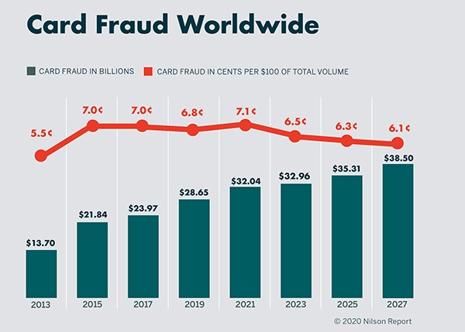
STATEMENT OF PROBLEM
Source: Nilson

Slide 5
STATEMENT OF PROBLEM
Forms of Credit Card Fraud
Data Breaches
Synthetic Fraud
Credit Card Skimming
Card-not-present fraud
Notes:
Reputation and overall client relationship

Slide 6
SIGNIFICANCE OF STUDY
The benefits of this research work is to incorporate analytical modelling techniques to improve existing algorithms that can predict fraudulent acts with a very high accuracy.

Slide 7
COMPARATIVE LITERATURE STUDY
AUTHORS | OBJECTIVE | METHOD EMPLOYED | LIMITATIONS
Darwish (2020) | Enhancing the accuracy of the classifications | Proposed a hybrid model that fuses two classifiers together. | Two separate classifiers with two different functions
Warghade et al. (2020) | Analysis and implementation of various machine learning techniques | Used multiple metrics for judging multiple classifiers | A small percentage of genuine transactions were misclassified
Shirgave et al. (2019) | Comparing Techniques Using instruments like accuracy, precision and specificity | Used a supervised Random Forest Algorithm | The issue of an unbalanced dataset was a slight setback
Notes:
During the course of my research, I came across a number of interesting works, some of which I would share with you this morning
Darwish – fuses two algorithmic classifiers together to enhance their predictive accuracy
Warghade et al used multiple *metrics in the analysis and implementation of machine learning techniques
When using accuracy and precision to compare techniques, Shirgave et al used a Random Forest Algorithm, although the issue of a Class unbalanced dataset proved to be a problem

Slide 8
GENERAL OBJECTIVE
This research focuses on the use of three algorithms to structure a suitable analytic model which is able to detect an accurate number of false positives in real time transactions.
Notes:
Is centered on the use of….detect an accurate number of false possitive transactions in real time

Slide 9
SPECIFIC OBJECTIVES
To identify suspicious events while letting normal transactions take place
To better reduce the frequency of false declines, where the system wrongly flags a legitimate transaction
To explore three analytical modelling techniques to provide an accurate model producing accurate result.
Notes:
…declines of legitimate transactions

Slide 10
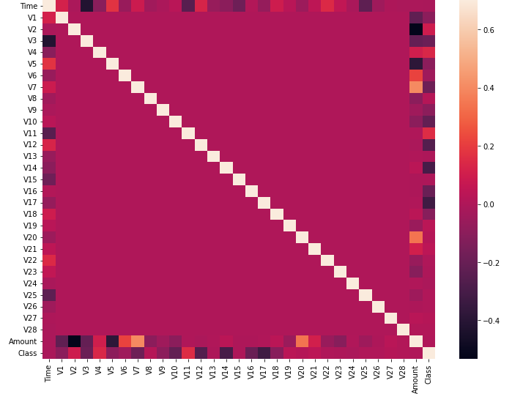
METHODOLOGY

Slide 11
METHODOLOGY
Test
Set
Train/Test Loop
Creation
Feature Extraction
Training Set
Model Training/
Building
Test Model Predictions
Historical Data
Production
Stream
Deployed Model
Predictions
Architecture of the design methodology

Slide 12
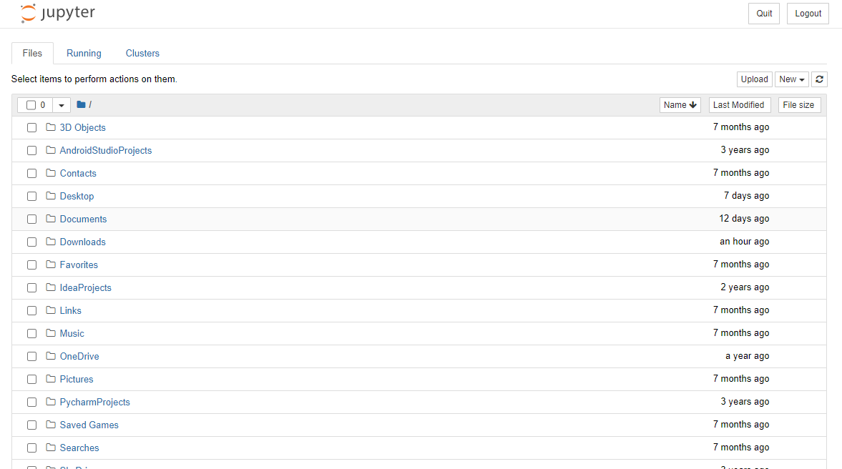
METHODOLOGY
Screencap of Jupyter Notebook Landing Page

Slide 13
IMPLEMENTATION
Logistic Regression
Isolation Forest
KNN Classifier

Slide 14
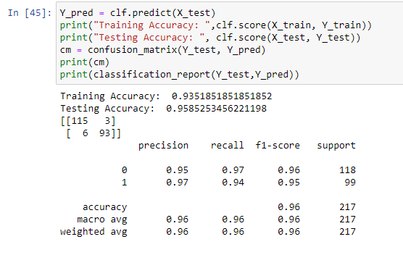
IMPLEMENTATION
Logistic Regression

Slide 15
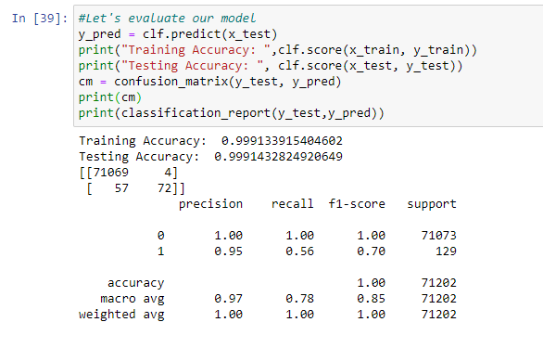
IMPLEMENTATION
Distributed Dataframe using Logistic Regression Model

Slide 16
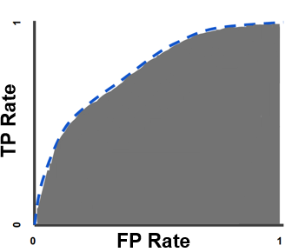
IMPLEMENTATION
AUC-ROC Curve of True Positive Rate and False Positive Rate

Slide 17
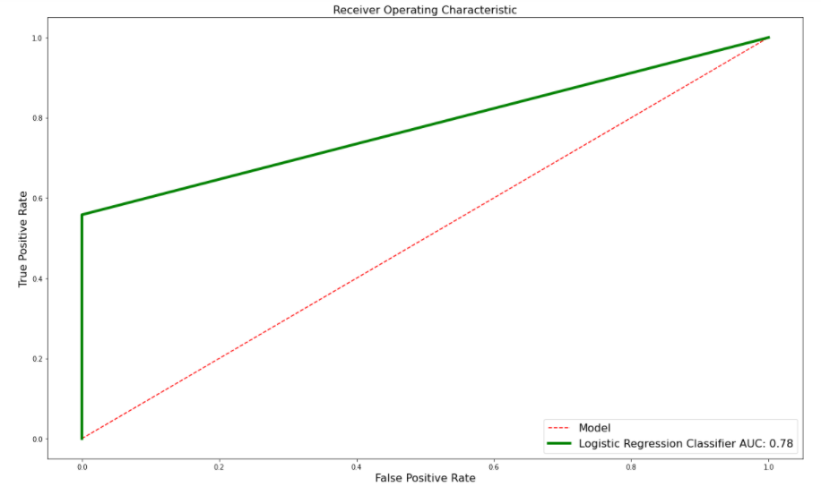
IMPLEMENTATION
Logistic Regression

Slide 18
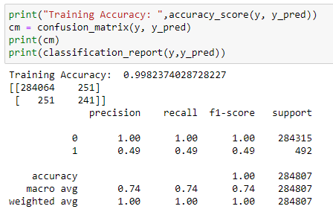
IMPLEMENTATION
Isolation Forest Algorithm

Slide 19
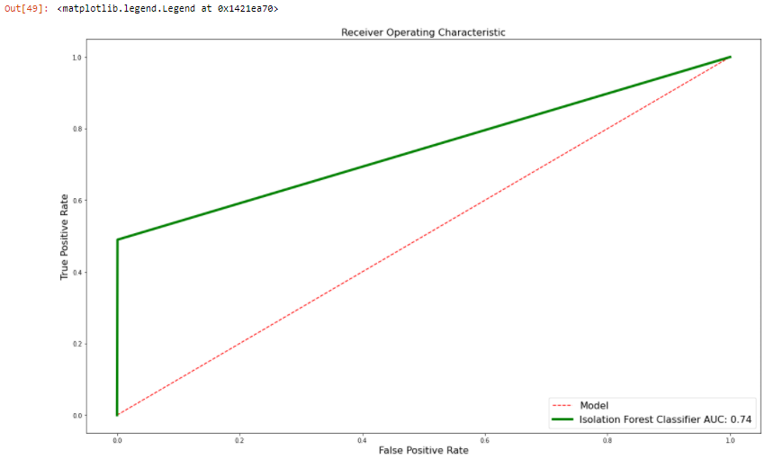
IMPLEMENTATION
Isolation Forest Algorithm

Slide 20
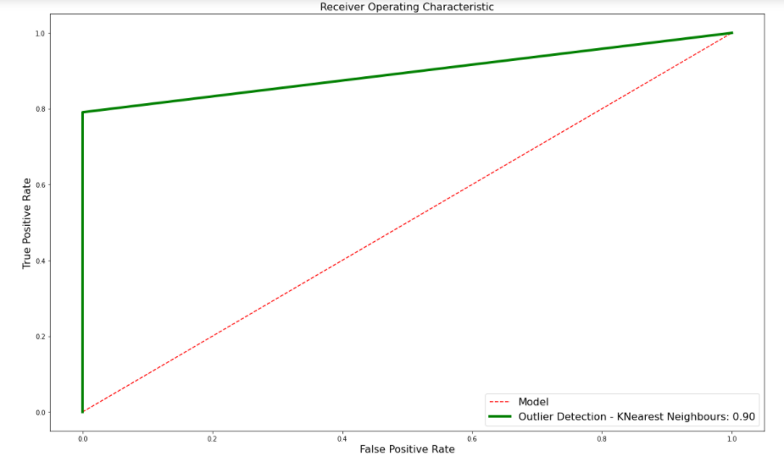
IMPLEMENTATION
KNN
KNearestNeigbours Classifier

Slide 21
CONTRIBUTION TO KNOWLEDGE
Through the evaluation of these techniques, these statistical models proved to be ideal for anomaly detection. This research can be used by E-Commerce platforms, credit card merchants and financial institutions alike to curb the ever rising cases of fraudulent activities.

Slide 22
REFERENCES
Alenzi, H. Z., & Aljehane, N. O. (2020). Fraud Detection in Credit Cards using Logistic Regression. International Journal of Advanced Computer science and applications (IJACSA), 11(12).
Ayorinde, K. (2021). A Methodology for Detecting Credit Card Fraud (Doctoral dissertation, Minnesota State University, Mankato).
Darwish, S. M. (2020). An intelligent credit card fraud detection approach based on semantic fusion of two classifiers. Soft Computing, 24(2), 1243-1253.
Maniraj, S. P., Saini, A., Ahmed, S., & Sarkar, S. (2019). Credit card fraud detection using machine learning and data science. International Journal of Engineering Research and, 8(09).
Marchal, S., & Szyller, S. (2019, December). Detecting organized eCommerce fraud using scalable categorical clustering. In Proceedings of the 35th Annual Computer Security Applications Conference (215-228).
Raj, S. B. E., & Portia, A. A. (2011, March). Analysis on credit card fraud detection methods. In 2011 International Conference on Computer, Communication and Electrical Technology (ICCCET) (152-156). IEEE.
Shirgave, S., Awati, C., More, R., & Patil, S. (2019). A Review On Credit Card Fraud Detection Using Machine Learning. Int. J. Sci. Technol. Res, 8, 1217-1220
Wang, C., & Han, D. (2019). Credit card fraud forecasting model based on clustering analysis and integrated support vector machine. Cluster Computing, 22(6), 13861-13866.
Warghade, S., Desai, S., & Patil, V. (2020). Credit Card Fraud Detection from Imbalanced Dataset Using Machine Learning Algorithm. International Journal of Computer Trends and Technology, 68, 22-28.

Slide 23
THANK YOU

